Slide 1

Shape of Data: Skewness and Kurtosis
Presented by Vincent Daher

Slide 2
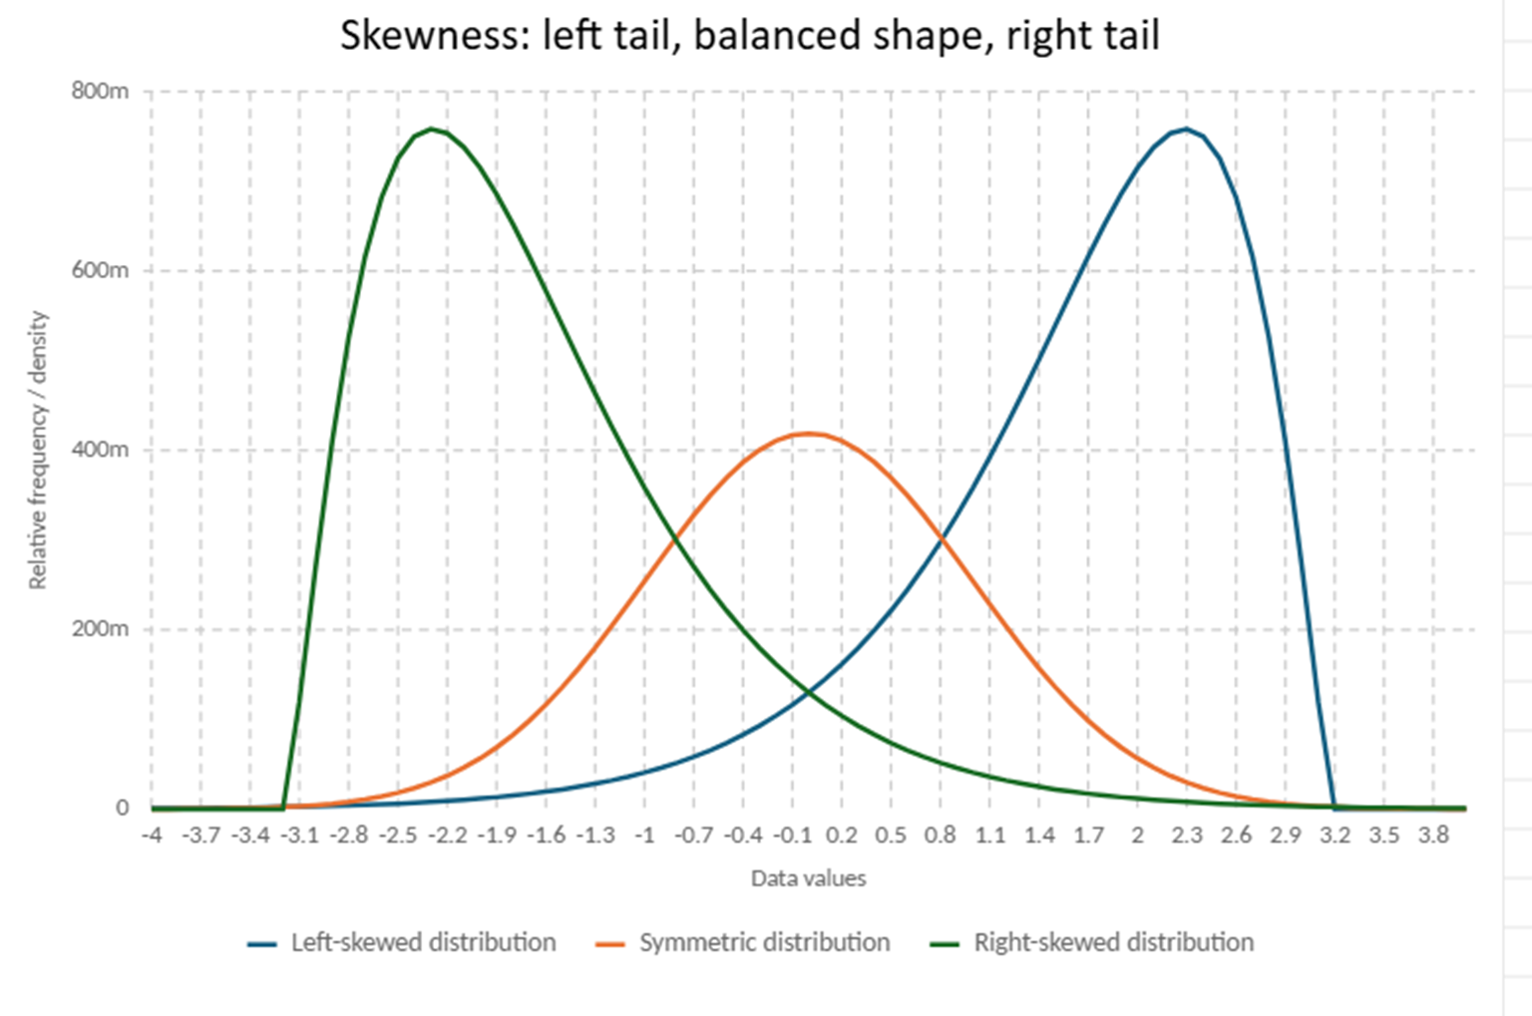
3. Left-skewed / Negative skewnessThe long tail goes to the left.A few very low values pull the mean to the left.Usually: Mean < Median < Mode.Example: an easy exam where most students got high marks but a few failed.
2. Right-skewed / Positive skewness The long tail goes to the right. A few very high values pull the mean to the right. Usually: Mode < Median < Mean. Example: income/salaries.
Skewness means the asymmetry of data. It tells us if the graph has a longer tail on the right or on the left.
1. Symmetric distribution The graph is balanced. Mean ≈ Median ≈ Mode. Skewness ≈ 0.
Skewness is about the direction of the tail, not where most data is.

Slide 3
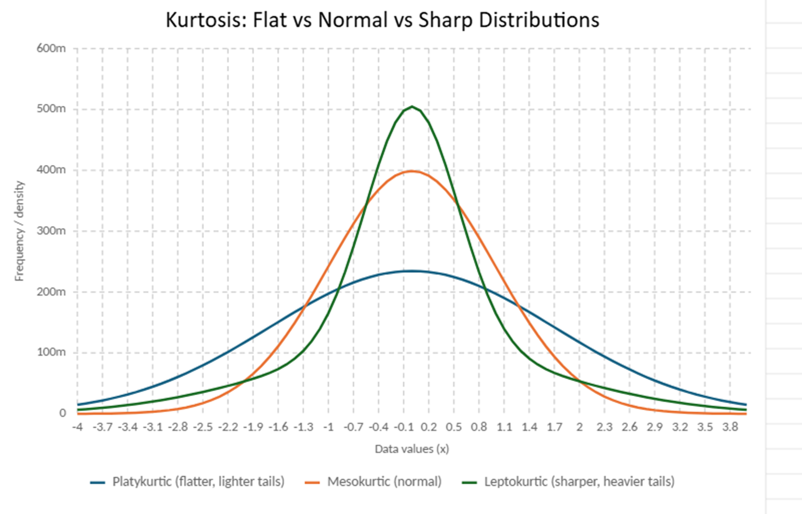
The 3 types:
Kurtosis describes the shape of a distribution, especially the heaviness of the tails and the presence of extreme values.
Leptokurtic: A sharper, taller peak with heavier tails; it usually indicates more extreme values or outliers.
Mesokurtic: A normal-shaped distribution with a balanced peak and normal tails; extreme values are not unusual or excessive.
Platykurtic: A flatter and wider distribution with lighter tails; it usually indicates fewer extreme values and more spread-out data.
Kurtosis is not only about how tall the curve is. It is mainly about the tails and extreme values.

Slide 4
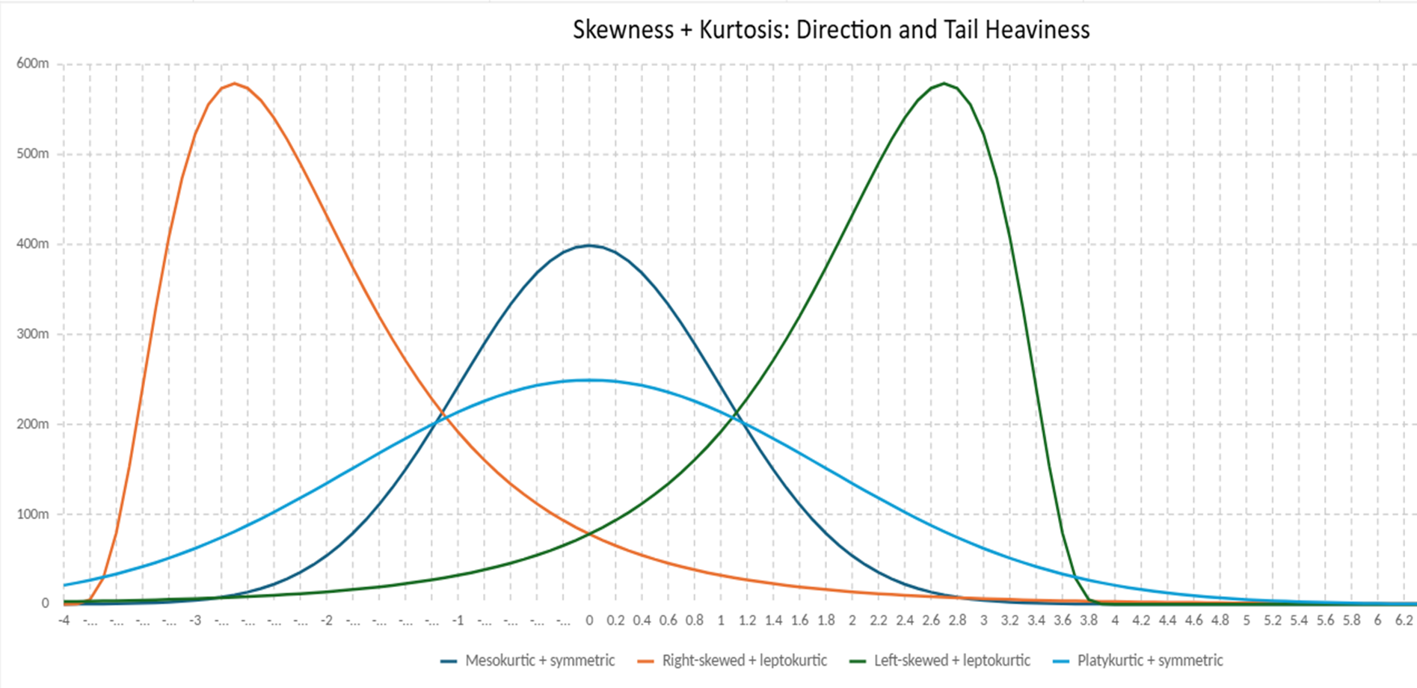
Leptokurtic:
Platykurtic:
Mesokurtic:
Skewness answers: “Where does the tail go?”
Kurtosis answers: “How heavy or extreme are the tails?”
Skewness and kurtosis describe two different aspects of a distribution.
Skewness tells us the direction of the tail: left, right, or balanced. Kurtosis tells us the heaviness of the tails and how common extreme values are.
midle
right
left

Slide 5
Final Example: How to Read Data Using Skewness + Kurtosis
Imagine we have the exam grades of a class.
The graph shows:
Most students scored around 13/20
A few students scored very low, around 2/20 or 3/20
The curve has a longer tail on the left side
The tails are a bit heavy because there are some extreme low scores
This class is generally doing well because most grades are high, but the teacher should not ignore the few students with very low results.
Skewness tells us the problem is on the low-score side. Kurtosis tells us that the low scores are extreme enough to matter.
By combining skewness and kurtosis, we do not only see the average performance; we also understand where the imbalance is and whether extreme values are affecting the data.

